Slide 1











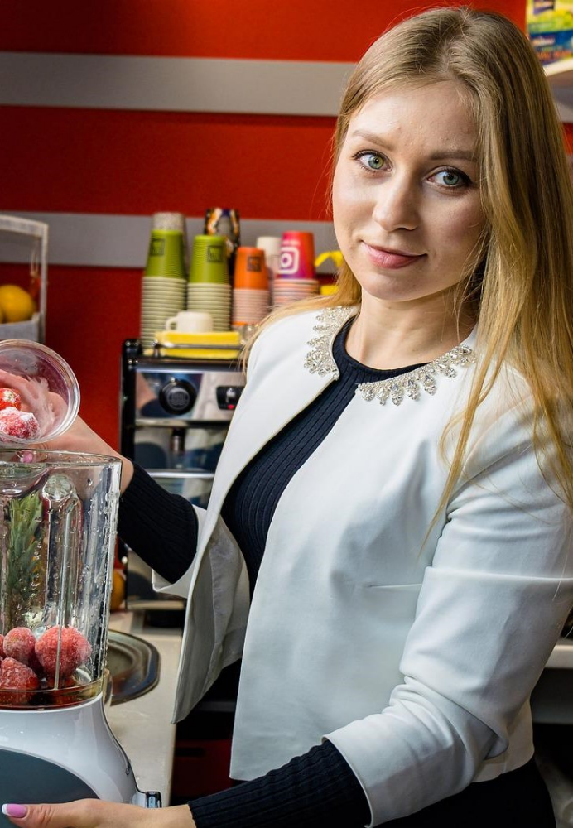
Yanqing Duan, Yongmei Bentley and Patricia Wilson, Business and Management Research Institute (BMRI), University of Bedfordshire
Overview
Curriculum
The main aim of the project is to support the growth of women entrepreneurs in Agri-Food sector by developing a specific training course and mentorship resources. This project will equip current and aspiring women entrepreneurs with the knowledge, skills and confidence which will leverage their business concepts into fruition. There is a social need to increase the engagement of women and reduce
The primary output of the project is ‘Start your own food business’ Curriculum for online course development. The Needs Analysis Review has been performed and several industry experts, food entrepreneurs and academics have been consulted. The content has been informed by the results of a survey carried out with existing and potential women across Europe ensuring that curriculum meets the needs of this unique group.
the gender gap in this sector. Only 28% of the farms across the EU are managed by women, and just 4% of female farmers are under the age of 35 (Eurostat, 2016). Earlier research confirmed that women across Europe have very different training needs than men. Therefore, it’s essential that they are prepared to overcome such challenges through specific support and further development.
The type of training moves away from the traditional theory-based classroom style teaching. It explores practical learning methods of teaching and learning i.e., enabling potential women entrepreneurs to learn from existing entrepreneurs. A key feature of this curriculum is that it can be adapted to suit the needs of the specific learner.
AWARE: Advancing Women in Agri-food Rural Environments
Course Modules
Resources
A woman and a farmer - addressing the challenges and barriers experienced by women in a male dominated agri-food sector.
Recognising Opportunity - covering topics on market research, business modelling, financing, innovative thinking and use of various tools and techniques.
The role of the Mentor - identifying and engaging with the correct mentor to suit the needs and style of business of the mentee.
Food Sector Specific Skills - providing information on food regulation, nutrition, labelling, packaging, food quality and safety.
Project website: https://agriwomenaware.eu/
Coordinator:
Galway-Mayo Institute Of Technology (Ireland)
Partners:
University of Bedfordshire (UK)
Confederazione Italiana Agricoltori Toscan (Italy)
PROPEL Europe (Belgium)
Polish Farm Advisory and Training Centre (Poland)
Macra na Feirme (Ireland)
Contact information:
Professor Yanqing Duan: yanqing.duan@beds.ac.uk

